Slide 1
CSE 3529
System Analysis and Design
International Islamic University Chittagong
Mohammed Arif Hasnayeen (MAH)

Slide 2
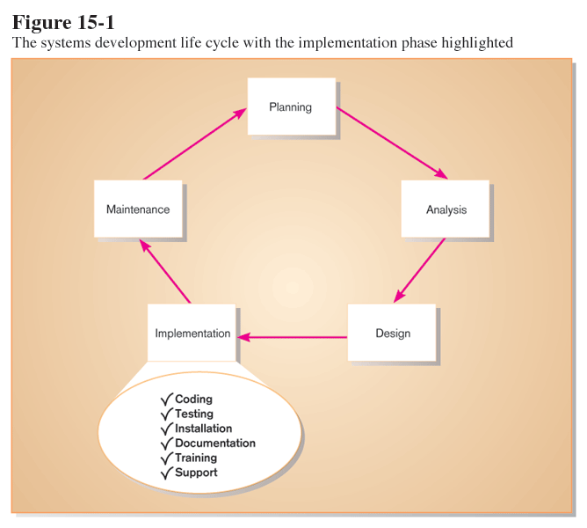

Slide 3
Purpose of System Implementation
To convert final physical system specifications into working and reliable software
To document work that has been done
To provide help for current and future users
Six major activities:
  Coding
  Testing
  Installation
  Documentation
  Training
  Support

Slide 4
The Process of Coding, Testing and Installation
Coding
  Physical design specifications are turned into working computer code.
Testing
  Tests are performed using various strategies.
  Testing can be performed in parallel with coding.
Installation
  The current system is replaced by the new system.

Slide 5
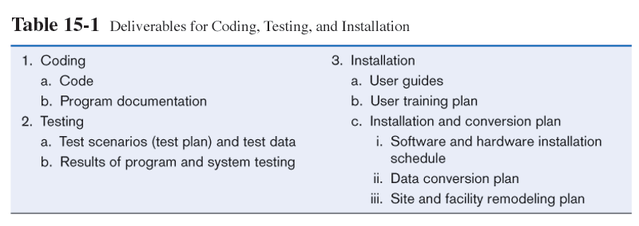
Deliverables

Slide 6
The Process of Documenting the System, Training Users, and Supporting Users
Two audiences for final documentation
  Information systems personnel who will maintain the system throughout its productive life
  People who will use the system as part of their daily lives
User Training
  Some of the training and support may be Application-specific
  Whereas the rest is general to particular operating systems or off-the-shelf software packages

Slide 7
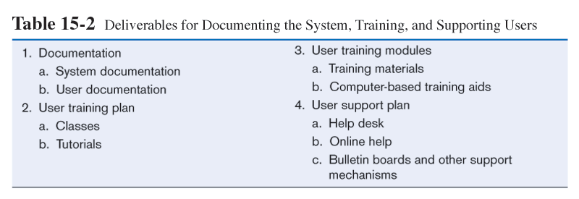
Deliverables

Slide 8
Software Application Testing
A master test plan is developed during the analysis phase.
During the design phase, unit, system and integration test plans are developed.
The actual testing is done during implementation.
Test plans provide improved communication among all parties involved in testing.

Slide 9
Testing methods
In unit testing, each module is tested alone in an attempt to discover any errors in its code.
Integration testing is the process of bringing together all of the modules that a program comprises for testing purposes; the modules are typically integrated in a top-down, incremental fashion
System testing is the process of bringing together all of the programs that a system comprises for testing purposes; programs are typically integrated in a top-down, incremental fashion

Slide 10
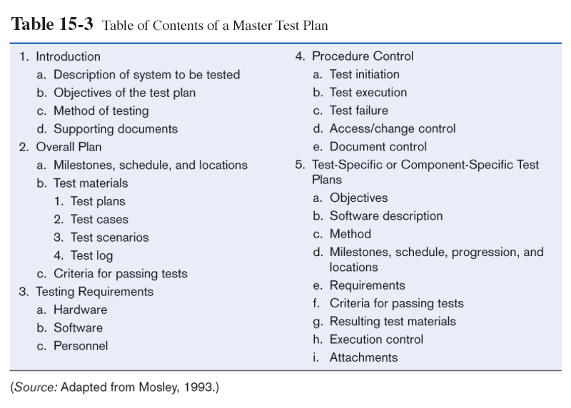

Slide 11
Test Classification
Static testing means that the code being tested is not executed.
Dynamic testing involves execution of the code
Automated testing means that the computer conducts the test.
Manual testing means that people complete the test.

Slide 12
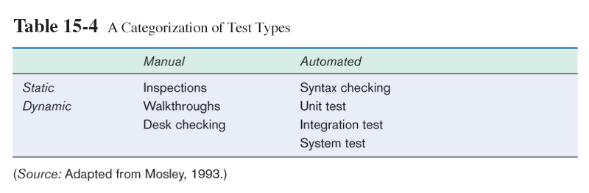
Test Classification
Manual vs. Automated
Static (syntax only) vs. Dynamic (execution)

Slide 13
Manual Testing Techniques
Inspection
  A testing technique in which participants examine program code for predictable language-specific errors
Walkthrough
  A peer group review of any product created during the systems development process; also called a structured walkthrough
Desk Checking
  A testing technique in which the program code is sequentially executed manually by the reviewer

Slide 14
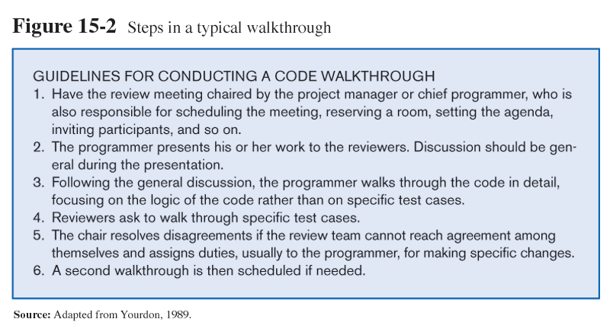

Slide 15
Automated Testing Techniques
Syntax Checking
  The compiler is run against the source code to identify syntax errors.
Unit Testing
  Each module is tested alone in an attempt to discover any errors in its code, also called module testing.
Integration Testing
  The process of bringing together all of the modules that a program comprises for testing purposes. Modules are typically integrated in a top-down, incremental fashion.

Slide 16
Automated Testing Techniques (cont.)
System Testing
  The bringing together of all the programs that a system comprises for testing purposes. Programs are typically integrated in a top-down, incremental fashion.
  Each module is tested as it is written. Since top- level modules contain many calls to subordinate (lower-level) modules , if the lower level modules haven’t been written yet, what will you do? The answer is stub testing
.

Slide 17
Stub Testing
Stub Testing
  A technique used in testing, especially where modules are written and tested in a top-down fashion, where a few lines of code are used to substitute for subordinate modules

Slide 18
Software Application Testing
The Testing Process
Two important points to remember about testing information systems:
The purpose of the testing is confirming that the system satisfies requirements
Testing must be planned
  We must pay attention to many different aspects of a system, such as response time , response to boundary data ,response to no input, response to heavy volume of input, and so on.

Slide 19
The Testing Process
Planning gives analysts an opportunity to think through all the potential problem areas, list these areas, and develop ways to test such problems. One part of the master test plan is creating a set of test cases.

Slide 20
Test Cases
  A specific scenario of transactions, queries or navigation paths that represent a typical, critical or abnormal use of the system
  Test cases and results should be thoroughly documented so they can be repeated for each revision of an application (rerun when the new version of software was developed).

Slide 21
Test Cases (cont.)
Test cases are usually developed by analysts.
Test cases should not be created by the programmers.
Separate people should program and test in order to ensure objectivity.
Programmers use symbolic debuggers to isolate causes for errors.

Slide 22
User Acceptance Testing
Actual users test a completed information system.
End result is the users’ final acceptance of the system.
Alpha testing: use simulated data
Beta testing: use real data in real user environment

Slide 23
Types of Alpha Tests
Recovery testing
  Forces software (or environment) to fail in order to verify that recovery is properly performed
Security testing
  Verifies that protection mechanisms built into the system will protect it from improper penetration
Stress testing
  Tries to break the system
Performance testing
  Determines how the system performs on the range of possible environments in which it may be used (eg different hardware configurations ,networks, operating systems and so on)

Slide 24
Installation
The organizational process of changing over from the current information system to a new one
Four approaches
  Direct Installation
    Changing over from the old information system to a new one by turning off the old system when the new one is turned on
  Parallel Installation
    Running the old information system and the new one at the same time until management decides the old system can be turned off

Slide 25
Installation
  Single location installation
    Trying out an information system at one site and using the experience to decide if and how the new system should be deployed throughout the organization
    Eg: Install the system in the branch/smaller unit first
  Phased Installation
    Changing from the old information system to the new one incrementally, starting with one or a few functional components and then gradually extending the installation to cover the whole new system
    Example: Install the purchasing system first, then followed by inventory system and etc.

Slide 26
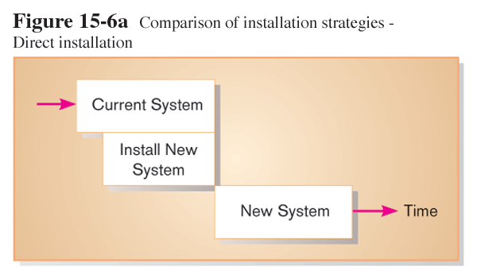
Turning off the old system when the new one is turned on

Slide 27
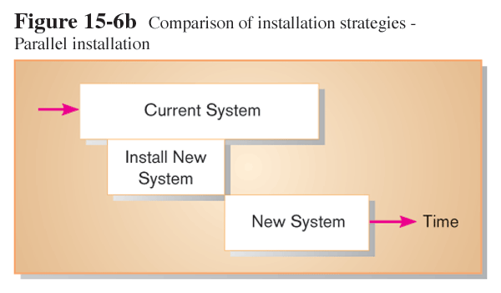
Running the old and new information systems at the same time until management decides the old system can be turned off

Slide 28
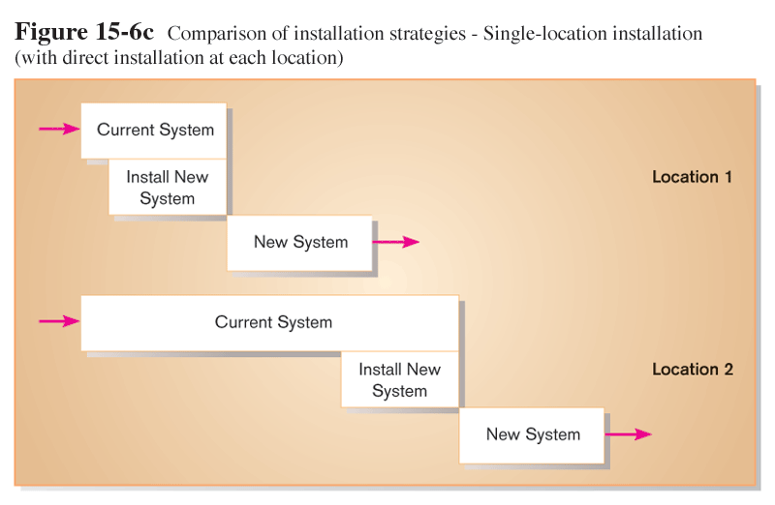
Trying out an information system at one site, then deciding if and how the new system should be deployed throughout the organization

Slide 29
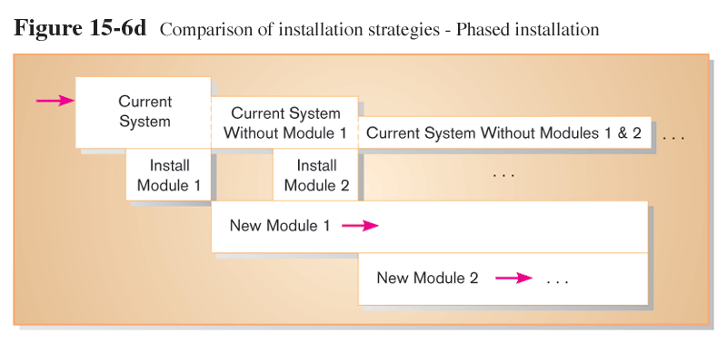
Changing from the old information system to the new one incrementally, starting with one or a few functional components and then gradually extending the installation to cover the whole new system

Slide 30
Planning Installation
Considerations
Data conversion from existing system to new system
Since existing systems usually contain data required by the new system, current data must be made error free, unloaded from current files, combined with new data, and loaded into new files.
Loading from current system / (compatibility)
Special procedures to let users inform IS department on the problem encountered.
Extra emergency staff to be available in case if system failure occurs
Planned old system shutdown

Slide 31
Documenting The System
Documentations can be categorized into two basic types:
System documentation and
User documentation
System documentation
  Detailed information about a system’s design specifications, its internal workings and its functionality

Slide 32
Documenting The System
  System documentation can further be divided into internal and external documentation
  Internal documentation
    System documentation that is part of the program source code or is generated at compile time
  External documentation
    System documentation that includes the outcome of structured diagramming techniques such as data flow and entity-relationship diagrams

Slide 33
Documenting The System
User Documentation
  Written or other visual information about an application system, how it works, and how to use it
Preparing user documentation
  Traditional source has been information systems department
  Application-oriented documentation whose purpose is to increase user understanding and utilization of organization’s computing resources has also become important. While some of this user-oriented documentation continues to be supplied by the information systems department, much of it now originates from vendors and users themselves

Slide 34
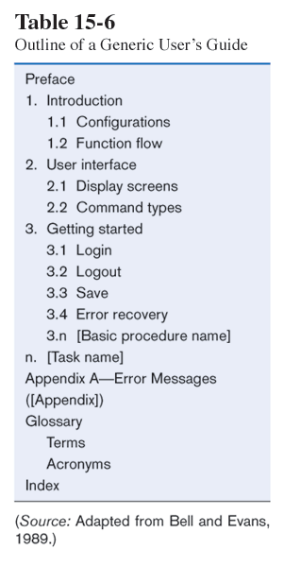
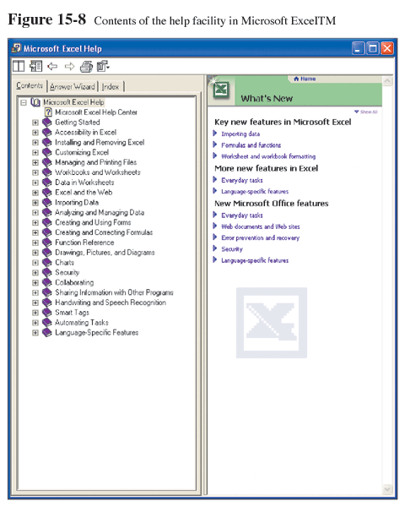
User documentation is typically in the form of online help

Slide 35
Training Information Systems Users
Potential training topics
  Use of the system (example: how to enter a class registration request/application)
  General computer concepts (example: how to copy the computer files)
  Information system concepts (example: batch processing, clustering)
  Organizational concepts (example: First in First out (FIFO) inventory accounting)
  System management (example: how to request changes to a system)
  System installation ( example: how to reconcile/do adjustment current and the new system)

Slide 36
Training Information Systems Users
Seven common Training methods:
1.Resident expert ( consult colleagues )
2.Computer-aided instruction (step by step learning guideline)
3.Formal courses (several instructors taught in a series of classes).
4.Software help components ( from help files)
5.Tutorials ( one instructor taught at a time)
6.Interactive training manuals (combination of tutorials and computer aided instruction)
7.External sources, such as vendors

Slide 37
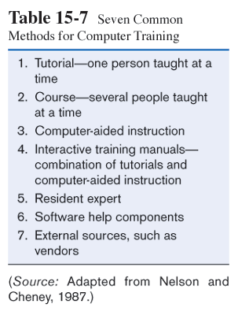
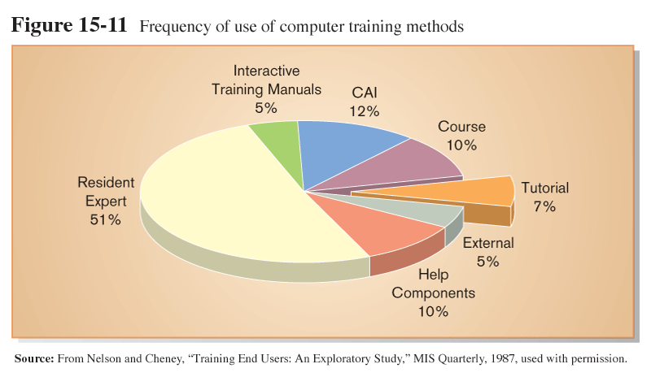
By far the most common training method is informal, via interaction with an in-house expert on the software

Slide 38
Electronic performance support system (EPSS)
Training modes now include videos, interactive television, multimedia training, on-line tutorials, and electronic performance support systems (EPSS). They may be delivered via video tapes, CD-ROMs, company intranets, and the Internet
EPSS is a Component of a software package or application in which training and educational information is embedded. Can be on line help systems that go beyond simply providing help – they embed training directly into a software package.
Users learn at their own pace and on their own machines. Reduce travel expenses and not required to send user off-site for weeks.
Guide the user step by step through a task, coaching the user on what to do and allow the user to get additional on line assistance.

Slide 39
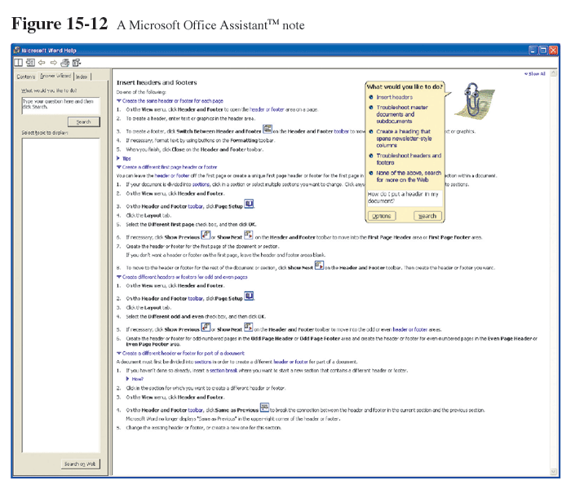
Electronic Performance Support Systems (EPSS), like Microsoft Office Assistant, are components of software applications that embed training and information for the user, in the form of tutorials, expert systems, and hyperlink jumps to reference topics.

Slide 40
Supporting Information Systems Users
Support is extremely important to users
Providing support can be expensive and time-consuming
One approach is through automation
  Internet-based online support forums
  On-demand fax
  Voice response systems
  Knowledge bases (enables users access vendors knowledge bases including electronic support systems)

Slide 41
Providing Support via Help Desk
A single point of contact for all user inquiries and problems about a particular information system or for all users in a particular department
Requires
  Technical skills: extensive knowledge about how to use the system and typical problems that can be encountered
  People skills: good listening and communication, dealing with complaints and frustrations

Slide 42
Support Issues for the Analyst to consider
Support is more than just answering user questions about how to use a system-support also consists of such tasks as providing for
Recovery and backup
Disaster recovery
PC maintenance
Writing newsletters
Setting up user groups

Slide 43
Implementation Success Factors
Biggest measure of success: will the new system be used?
Major factors influencing the extent to which a system is used:
  Personal stake of users (How relevant the system is to the work the user performs)
  System characteristics (ease of use, reliability, and relevance to the task)
  User demographics (age, degree of computer experience)
  Organizational support
  Performance
  Satisfaction

Slide 44
Project Close-Down
Evaluate team members
  Reassign members to other projects or terminate
Notify all affected parties that the development project is ending and that you are switching to operation and maintenance mode
Conduct post project reviews with both your management and your customers
Close out customer contract
  Formal signoff
17.<number>

